Slide 1
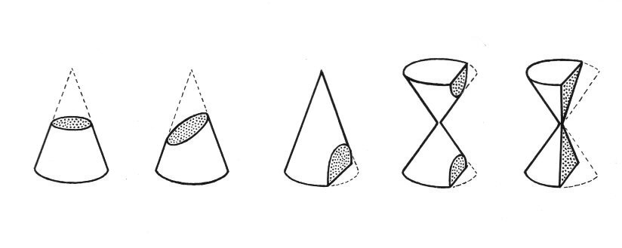
Conic Sections
In our (somewhat) everyday life

Slide 2
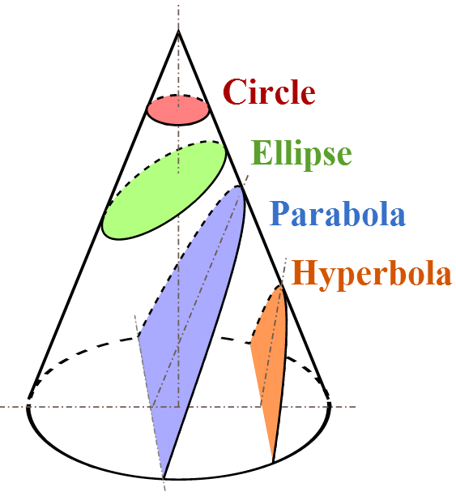
What are conics?
There is no better example of this than the work done by the ancient Greeks on the curves known as the conics: the ellipse, the parabola, and the hyperbola.
No important scientific applications were found for them until the 17th century, when Kepler discovered that planets move in ellipses and Galileo proved that projectiles travel in parabolas.
In mathematics, a conic section is a curve obtained by intersecting a right circular conical surface with a plane.

Slide 3
Types Of conic Sections:
Ellipse (including Circles) Parabola
Hyperbola
Circle
Ellipse
Parabola
Hyperbola

Slide 4
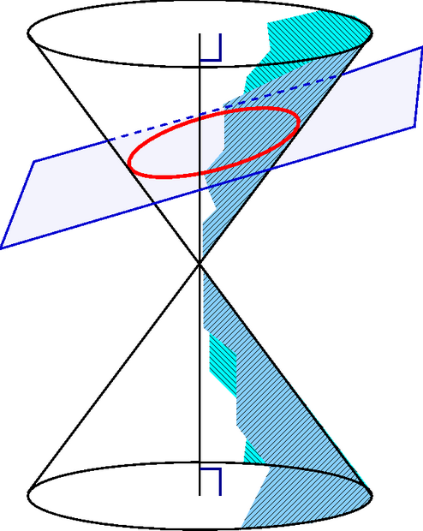
1) Ellipse
An ellipse is also the locus of all points of the plane whose distances to two fixed points add to the same constant. An ellipse obtained as the intersection of a cone with a plane.

Slide 5
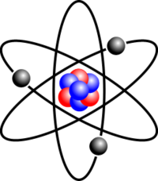
Though not so simple as the circle, the ellipse is nevertheless the curve most often "seen" in everyday life. The reason is that every circle, viewed obliquely, appears elliptical.
On a far smaller scale, the electrons of an atom move in an approximately elliptical orbit with the nucleus at one focus.

Slide 6
The ellipse has an important property that is used in the reflection of light and sound waves.
Any light or signal that starts at one focus will be reflected to the other focus.
This principle is used in lithotripsy , a medical procedure for treating kidney stones.
The patient is placed in a elliptical tank of water, with the kidney stone at one focus. High-energy shock waves generated at the other focus are concentrated on the stone, pulverizing it.

Slide 7
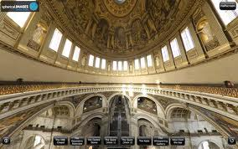
The principle is also used in the construction of "whispering galleries" such as in St. Paul's Cathedral in London. If a person whispers near one focus, he can be heard at the other focus, although he cannot be heard at many places in between.

Slide 8
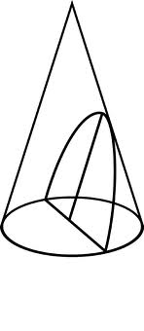
2) Parabola
The parabola is a conic section, the intersection of a right circular conical surface and a plane parallel to a generating straight line of that surface.

Slide 9
Properties Of Parabola:
Properties Of Parabola One of nature's best known approximations to parabolas is the path taken by a body projected upward and obliquely to the pull of gravity, as in the parabolic trajectory of a golf ball.
The friction of air and the pull of gravity will change slightly the projectile's path from that of a true parabola, but in many cases the error is insignificant. Parabolas exhibit unusual and useful reflective properties.

Slide 10
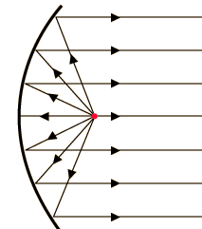
Parabolas exhibit unusual and useful reflective properties. If a light is placed at the focus of a parabolic mirror (a curved surface formed by rotating a parabola about its axis), the light will be reflected in rays parallel to said axis. In this way a straight beam of light is formed. It is for this reason that parabolic surfaces are used for headlamp reflectors. The bulb is placed at the focus for the high beam and a little above the focus for the low beam.

Slide 11
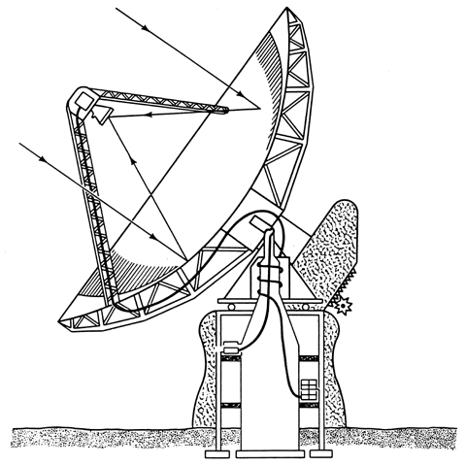
The opposite principle is used in the giant mirrors in reflecting telescopes and in antennas used to collect light and radio waves from outer space: the beam comes toward the parabolic surface and is brought into focus at the focal point.

Slide 12
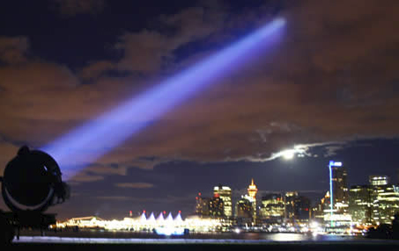
Used in Searchlights Light rays leaving the focus reflect out in parallel rays Used for Searchlights
Notice the parallel rays of light

Slide 13
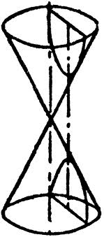
3) Hyperbola
Hyperbola If a right circular cone is intersected by a plane parallel to its axis, part of a hyperbola is formed. Such an intersection can occur in physical situations as simple as sharpening a pencil that has a polygonal cross section or in the patterns formed on a wall by a lamp shade.

Slide 14
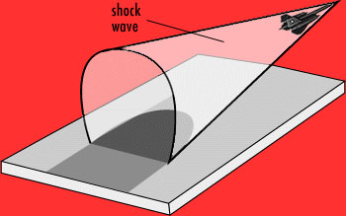
A sonic boom shock wave has the shape of a cone, and it intersects the ground in part of a hyperbola. It hits every point on this curve at the same time, so that people in different places along the curve on the ground hear it at the same time. Because the airplane is moving forward, the hyperbolic curve moves forward and eventually the boom can be heard by everyone in its path.

Slide 15
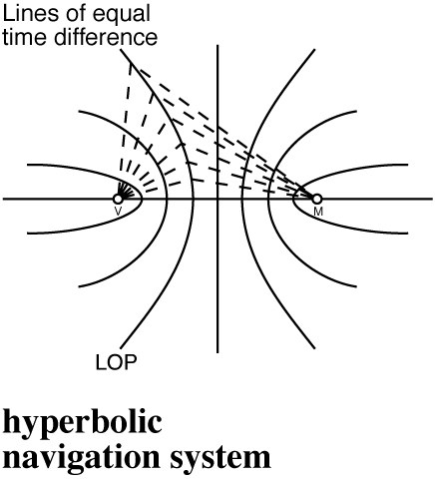
Radio waves and Navigation :
Radio waves and hyperbolas can be used in navigation. If the centre of each circle gives out a radio signal then the signals will intersect each other in hyperbolas. This is how hyperbolic radio navigation systems were created.

Slide 16
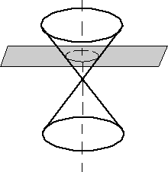
4) Circles
A circle is formed by cutting a circular cone with a plane perpendicular to the symmetry axis of the cone. This intersection is a closed curve, and the intersection is parallel to the plane generating the circle of the cone. A circle is also the set of all points that are equally distant from the center.

Slide 17
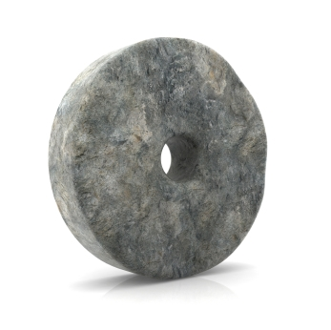
The invention of circular wheels is still considered mankind’s biggest step in transportation and communication.

Slide 18
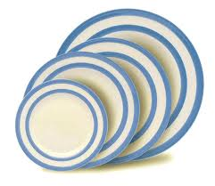
Why are plates circular?
Round plates used to be the easiest to manufacture, round plates were the easiest shape to control when working with clay, which can warp if it doesn't dry slowly and evenly. But it's probably not a big deal now.

Slide 19
Round plates are the most common because they are the most popular. And they are the most popular, in my opinion, because round plates are easiest to use:
They are the easiest shape to use, wash, and store. You don't have to check which way they go except "right-side up."
The food can go on the plate anywhere in the middle and it won't matter because the edge will be the same distance all around.
Round plates are easier to wash, you can use the same washing motion with your hand, every time, because the shape is always the same no matter where you are holding it.
Round plates are easiest to store. Ever tried to stack a lot of square or rectangular containers?

Slide 20
Symbolic meaning of circles -
Inclusion
Wholeness
Focus
Unity
Nurturing
Cycles
Initiation
Everything
Perfection
Womb
Centering
Revolution
Infinity
Mobility
Completion

Slide 21
Made by -
Nishant Baranwal Somy – 11127
Ram Kishore – 11130
Sagar Kowe – 11131
Shwetabh P. Singh – 11136

